Slide 1
VX 420: Business Basics for Entrepreneurship
Lecture 2
The Lean LaunchPad: Value Proposition
Version 6/15/12

Slide 2
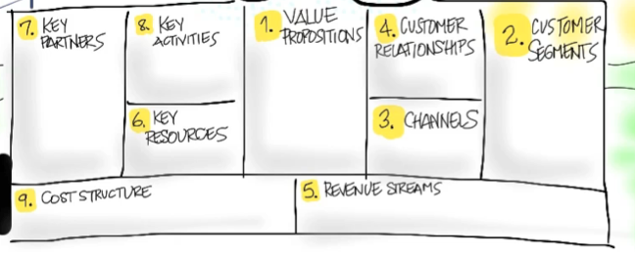
Value Proposition
What Are You Building and For Who?

Slide 3
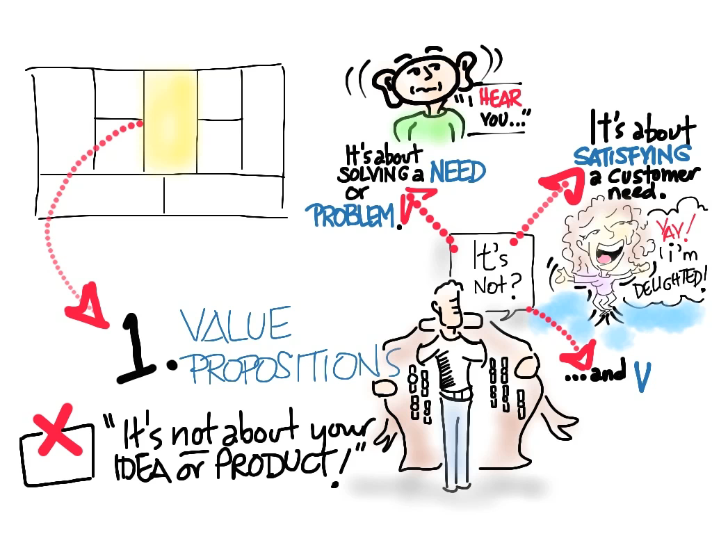
© 2012 Steve Blank

Slide 4
Product/Market
Fit

Slide 5
The Value Proposition
Gain Creators
MVP
Products & Services
Pain Killers

Slide 6
Pain = Customer Problem Gain = Customer Solution

Slide 7
The Customer Segment
Gains
Persona /Archetype
Jobs
Problem or Need
Pains
Market Type

Slide 8
Gain Creators
MVP
Gains
Products & Services
Persona /Archetype
Jobs
Problem or Need
Pain Killers
Pains
Product/Market
Fit

Slide 9
Product/Services

Slide 10
Value Proposition - Products
Which are part of your value proposition?
(e.g. manufactured goods, commodities, produce, ...)
Which intangible products are part?
(e.g. copyrights, licenses, ...)
Which financial products?
(e.g. financial guarantees, insurance policies, ...)
Which digital products?
(e.g. mp3 files, e-books, ...)

Slide 11
Value Proposition - Services
Which core services are part of your value proposition?
(e.g. consulting, a haircut, investment advice, ...)
Which pre-sales or sales services?
(e.g. help finding the right solution, financing, free delivery service, ...)
Which after-sales services?
(e.g. free maintenance, disposal, ...)

Slide 12
Pain Killers
Reduce or eliminate wasted time, costs, negative emotions, risks - during and after getting the job done

Slide 13
Pain Killers - Hypotheses
Produce savings?
(e.g. time, money, or efforts, …)
Make your customers feel better?
(e.g. kills frustrations, annoyances, things that give them a headache, ...)
Fix underperforming solutions?
(e.g. new features, better performance, better quality, ...)
Ends difficulties and challenges customers encounter?
(e.g. make things easier, helping them get done, eliminate resistance, ...)
wipe out negative social consequences?
(e.g. loss of face, power, trust, or status, ...)...
Eliminate risks
(e.g. financial, social, technical risks, or what could go awfully wrong, ...)

Slide 14
Pain Killer – Is it a Problem or Need?
Are you solving a Problem?
Are you fulfilling a Need?
For who?
How do you know?

Slide 15
Pain Killer - Ranking
Rank each pain your products and services kill according to their intensity for the customer.
Is it very intense or very light?
For each pain indicate the frequency at which it occurs

Slide 16
Gain Creators
How do they create benefits the customer expects, desires or is surprised by, including functional utility, social gains, positive emotions, and cost savings?

Slide 17
Gain Creators- Hypotheses
Create savings that make your customer happy?
(e.g. in terms of time, money and effort, ...)
Produce expected or better than expected outcomes?
(e.g. better quality level, more of something, less of something, ...)
Copy or outperform current solutions that delight customer?
(e.g. regarding specific features, performance, quality, ...)
Make your customer’s job or life easier?
(flatter learning curve, usability, accessibility, more services, lower cost of ownership, ...)
Create positive consequences that customer desires?
(makes them look good, produces an increase in power, status, ...).

Slide 18
Gain Creator- Ranking
Rank each gain your products and services create according to its relevance to the customer.
Is it substantial or insignificant?
For each gain indicate the frequency at which it occurs.

Slide 19
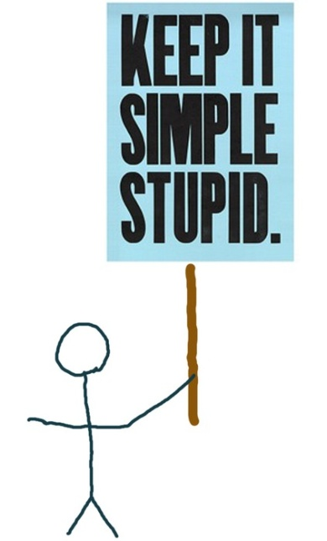
Minimum Viable Product

Slide 20
Define Minimum Viable Product – Physical
First, tests your understanding of the problem (pain)
Next tests your understanding of the solution (gain)
Proves that it solves a core problem for customers
The minimum set of features needed to learn from earlyvangelists
Interviews, demos, prototypes, etc
Lots of eyeball contact

Slide 21
Define the Minimum Viable Product – Web/Mobile
NOW build a “low fidelity” app for customer feedback
tests your understanding of the problem
LATER build a “high fidelity” app tests your understanding of the solution
Proves that it solves a core problem for customers
The minimum set of features needed to learn from earlyvangelists
Avoid building products nobody wants
Maximize the learning per time spent

Slide 22
The Art of the MVP
A MVP is not a minimal product
“But my customers don’t know what they want!”
At what point of “I don’t get it!” will I declare defeat?

Slide 23
Things to Consider

Slide 24
Value Proposition – Common Mistakes
It’s just a feature of someone else’s product
It’s a “nice to have” instead of a “got to have”
Not enough customers care

Slide 25
Questions for Value Proposition
Competition: What do customers do today?
Technology / Market Insight: Why is the problem so hard to solve?
Market Size: How big is this problem?
Product: How do you do it?

Slide 26
Key Questions for Value Prop
Problem Statement: What is the problem?
Ecosystem: For whom is this relevant?
Competition: What do customers do today?
Technology / Market Insight: Why is the problem so hard to solve?
Market Size: How big is this problem?
Product: How do you do it?

Slide 27
Technical Versus Market Insight
Notes:
First – how would you define product? (go through different teams)

Slide 28
Technology and Market Insight
Technology Insight
Moore’s Law
New scientific discoveries
Typically applies to hardware, clean tech and biotech
Market Insight
Value chain disruption
Deregulation
Changes in how people work, live and interact and what they expect
Notes:
Market insight is becoming more and more a requirement

Slide 29


Examples of Technical Insight
Topological analysis enables highly dimensional data to be analyzed without predetermining number of feature sets
Mass produced components can be used to create a miniaturized fluorescence microscope
Notes:
Generally a product / value proposition question

Slide 30



Examples of Market Insight
People want to play more involved games than what is currently offered
Facebook can be the distribution for such games
Masses of people are more likely to micro-blog than blog
The non-symmetric relationships will allow companies and individuals to self-promote and will impact distribution
European car sharing sensibilities could be adopted in North America
People, particularly in urban environments, no longer wanted to own cars but wanted to have flexibility.
Notes:
Generally impacts some part of your business model diagram (usually NOT the product component)

Slide 31
Types of Value Propositions
Comes from Technical Insight
Comes from Market Insight
More Efficient
Lower cost
Better Distribution
Better Bundling
Smaller
Faster
Simpler
Better Branding
Notes:
Others: Brand/Status, easier to access (distribution); fun; bundling (phone + camera) faster, simpler, smaller, lower cost, more efficient

Slide 32
Insight
All of you are starting with technical insight
All of you will get out of the building and get data
A few of view will get market insight

Slide 33
Examples
Notes:
First – how would you define product? (go through different teams)

Slide 34
Value proposition
Problem
Non-renewable, petroleum derived feedstock for surfactant, lubricant industry
Solution
Sustainable, bio-based replacement
Features of value proposition
Bi-functional molecules
Flexibility in chain length
Higher performance
Flexibility in branching
Improved cold temperature tolerance of detergents, lubricants

Slide 35
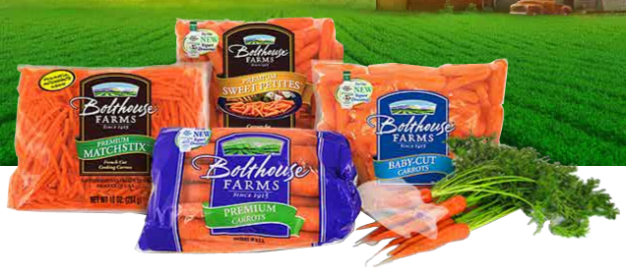

Hand weed control is a Nightmare
Crews of 100s needed
Labor getting harder to get
Back-breaking task
2-3 weedings per crop
Food contamination risk
$250-1,000 per acre
Confidential

Slide 36
Produced Water
Disposal
Dilution with Freshwater
Reuse to Frac Another Well
Primary Treatment
How high can they go?
This is where we fit in
Tertiary Treatment
Current state of the art are evaporators and crystallizers
Discharge
Must be drinking water quality

Slide 37
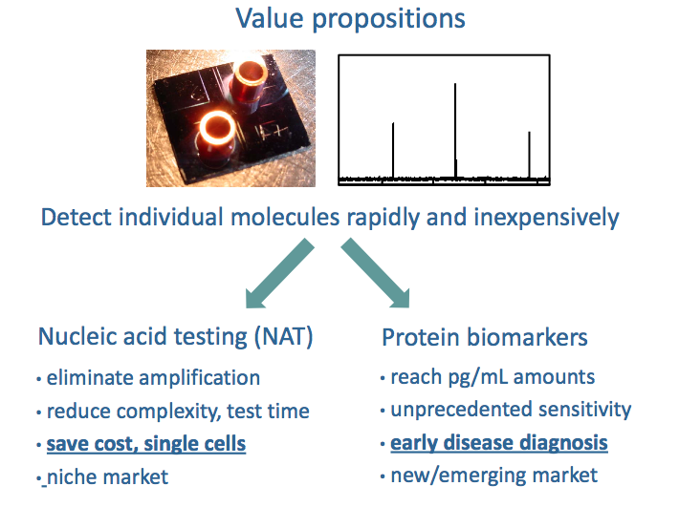

Slide 38

MammOptics
Initial Idea
Breast cancer
Mammography
Leading cause of cancer in women
190,000 diagnosis every year US
41,000 deaths every year US
Increasing diagnosis rates
15%-25% false negatives rate
25% false positives rate
Requires X-ray radiation
Low resolution
MammOptics
Novel technology based on RF-modulated optical spectroscopy
Earlier detection
Non-radiative
Non-invasive

Slide 39
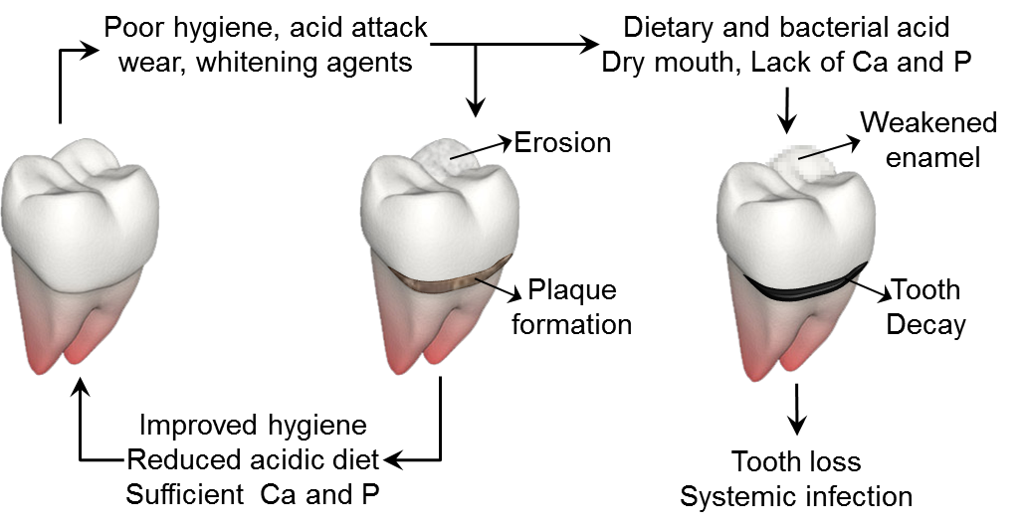
The Problem & Our Solution
De-mineralization
X
Problem: No products that reverses demineralization effectively
Our solution: Remineralization peptides that restore lost mineral

